Slide 1
Lecture 5:
Consolidation
SCIF10002 – Introduction to Coding and Data
Tom Maullin-Sapey
23rd October 2025
Slide 0/11

Slide 2
Today’s Lecture
Slide 1/11

Slide 3
Today’s Lecture
Lecture 5: Consolidation
Slide 1/11

Slide 4
Today’s Lecture
Lecture 5: Consolidation
Recap: The Course So Far
Slide 1/11

Slide 5
Today’s Lecture
Lecture 5: Consolidation
Recap: The Course So Far
Tackling Difficult Problems
Slide 1/11

Slide 6
Today’s Lecture
Lecture 5: Consolidation
Recap: The Course So Far
Tackling Difficult Problems
A Worked Example
Slide 1/11

Slide 7
Today’s Lecture
Lecture 5: Consolidation
Recap: The Course So Far
Tackling Difficult Problems
A Worked Example
Practical
Slide 1/11

Slide 8
Today’s Lecture
Lecture 5: Consolidation
Recap: The Course So Far
Tackling Difficult Problems
A Worked Example
Practical
Lecture 6: Introduction to NumPy
Recap: The Course So Far
What is NumPy?
NumPy Arrays
Arrays vs Lists
Practical
Slide 1/11

Slide 9
Recap: The Course So Far
Slide 2/11

Slide 10
Recap: The Course So Far
Over the last 4 weeks, we’ve covered the basics of Python
Slide 2/11

Slide 11
Recap: The Course So Far
Over the last 4 weeks, we’ve covered the basics of Python
We’ve looked at:
Slide 2/11

Slide 12
Recap: The Course So Far
Over the last 4 weeks, we’ve covered the basics of Python
We’ve looked at:
Datatypes
Slide 2/11

Slide 13
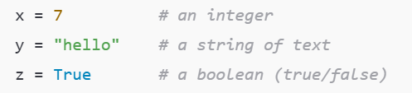
Recap: The Course So Far
Over the last 4 weeks, we’ve covered the basics of Python
We’ve looked at:
Datatypes
Slide 2/11

Slide 14
Recap: The Course So Far
Over the last 4 weeks, we’ve covered the basics of Python
We’ve looked at:
Datatypes
Slide 2/11

Slide 15
Recap: The Course So Far
Over the last 4 weeks, we’ve covered the basics of Python
We’ve looked at:
Datatypes
Slide 2/11

Slide 16
Recap: The Course So Far
Over the last 4 weeks, we’ve covered the basics of Python
We’ve looked at:
Datatypes
Slide 2/11

Slide 17
Recap: The Course So Far
Over the last 4 weeks, we’ve covered the basics of Python
We’ve looked at:
Datatypes
Conditional Logic
Slide 2/11

Slide 18
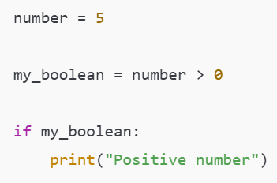
Recap: The Course So Far
Over the last 4 weeks, we’ve covered the basics of Python
We’ve looked at:
Datatypes
Conditional Logic
Slide 2/11

Slide 19
Recap: The Course So Far
Over the last 4 weeks, we’ve covered the basics of Python
We’ve looked at:
Datatypes
Conditional Logic
Slide 2/11

Slide 20
Recap: The Course So Far
Over the last 4 weeks, we’ve covered the basics of Python
We’ve looked at:
Datatypes
Conditional Logic
Slide 2/11

Slide 21
Recap: The Course So Far
Over the last 4 weeks, we’ve covered the basics of Python
We’ve looked at:
Datatypes
Conditional Logic
Slide 2/11

Slide 22
Recap: The Course So Far
Over the last 4 weeks, we’ve covered the basics of Python
We’ve looked at:
Datatypes
Conditional Logic
Loops
Slide 2/11

Slide 23
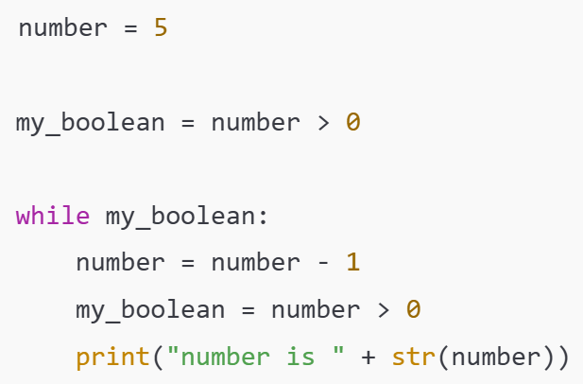
Recap: The Course So Far
Over the last 4 weeks, we’ve covered the basics of Python
We’ve looked at:
Datatypes
Conditional Logic
Loops
Slide 2/11

Slide 24
Recap: The Course So Far
Over the last 4 weeks, we’ve covered the basics of Python
We’ve looked at:
Datatypes
Conditional Logic
Loops
Slide 2/11

Slide 25
Recap: The Course So Far
Over the last 4 weeks, we’ve covered the basics of Python
We’ve looked at:
Datatypes
Conditional Logic
Loops
Slide 2/11

Slide 26
Recap: The Course So Far
Over the last 4 weeks, we’ve covered the basics of Python
We’ve looked at:
Datatypes
Conditional Logic
Loops
Slide 2/11

Slide 27
Recap: The Course So Far
Over the last 4 weeks, we’ve covered the basics of Python
We’ve looked at:
Datatypes
Conditional Logic
Loops
Slide 2/11

Slide 28
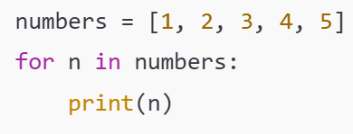
Recap: The Course So Far
Over the last 4 weeks, we’ve covered the basics of Python
We’ve looked at:
Datatypes
Conditional Logic
Loops
Slide 2/11

Slide 29
Recap: The Course So Far
Over the last 4 weeks, we’ve covered the basics of Python
We’ve looked at:
Datatypes
Conditional Logic
Loops
Slide 2/11

Slide 30
Recap: The Course So Far
Over the last 4 weeks, we’ve covered the basics of Python
We’ve looked at:
Datatypes
Conditional Logic
Loops
Slide 2/11

Slide 31
Recap: The Course So Far
Over the last 4 weeks, we’ve covered the basics of Python
We’ve looked at:
Datatypes
Conditional Logic
Loops
Slide 2/11

Slide 32
Recap: The Course So Far
Over the last 4 weeks, we’ve covered the basics of Python
We’ve looked at:
Datatypes
Conditional Logic
Loops
Functions
Slide 2/11

Slide 33
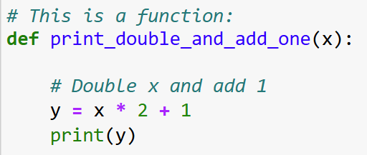
Recap: The Course So Far
Over the last 4 weeks, we’ve covered the basics of Python
We’ve looked at:
Datatypes
Conditional Logic
Loops
Functions
Slide 2/11

Slide 34
Recap: The Course So Far
Over the last 4 weeks, we’ve covered the basics of Python
We’ve looked at:
Datatypes
Conditional Logic
Loops
Functions
Slide 2/11

Slide 35
Recap: The Course So Far
Over the last 4 weeks, we’ve covered the basics of Python
We’ve looked at:
Datatypes
Conditional Logic
Loops
Functions
Slide 2/11

Slide 36
Recap: The Course So Far
Over the last 4 weeks, we’ve covered the basics of Python
We’ve looked at:
Datatypes
Conditional Logic
Loops
Functions
Before moving on to the next parts of the course…
Slide 2/11

Slide 37
Recap: The Course So Far
Over the last 4 weeks, we’ve covered the basics of Python
We’ve looked at:
Datatypes
Conditional Logic
Loops
Functions
Before moving on to the next parts of the course…
NumPy, Pandas and Matplotlib
Slide 2/11

Slide 38
Recap: The Course So Far
Over the last 4 weeks, we’ve covered the basics of Python
We’ve looked at:
Datatypes
Conditional Logic
Loops
Functions
Before moving on to the next parts of the course…
NumPy, Pandas and Matplotlib
… this week we are going to do some “consolidation challenges”
Slide 2/11

Slide 39
Recap: The Course So Far
Over the last 4 weeks, we’ve covered the basics of Python
We’ve looked at:
Datatypes
Conditional Logic
Loops
Functions
Before moving on to the next parts of the course…
NumPy, Pandas and Matplotlib
… this week we are going to do some “consolidation challenges”
Using what we have learnt to tackle the kinds of tasks you might encounter in the real world
Slide 2/11

Slide 40
Aside: Dictionaries
Slide 3/11

Slide 41
Aside: Dictionaries
Before we dive into today’s work, there is one concept we’d like to revisit in more detail
Slide 3/11

Slide 42
Aside: Dictionaries
Before we dive into today’s work, there is one concept we’d like to revisit in more detail
A dictionary, or “dict”, is a data type in Python
Slide 3/11

Slide 43
Aside: Dictionaries
Before we dive into today’s work, there is one concept we’d like to revisit in more detail
A dictionary, or “dict”, is a data type in Python
It allows us to store values under keys
Slide 3/11

Slide 44
Aside: Dictionaries
Before we dive into today’s work, there is one concept we’d like to revisit in more detail
A dictionary, or “dict”, is a data type in Python
It allows us to store values under keys
Think of a real-life dictionary
Slide 3/11

Slide 45
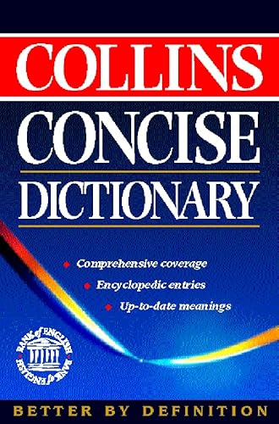
Aside: Dictionaries
Before we dive into today’s work, there is one concept we’d like to revisit in more detail
A dictionary, or “dict”, is a data type in Python
It allows us to store values under keys
Think of a real-life dictionary
Slide 3/11

Slide 46
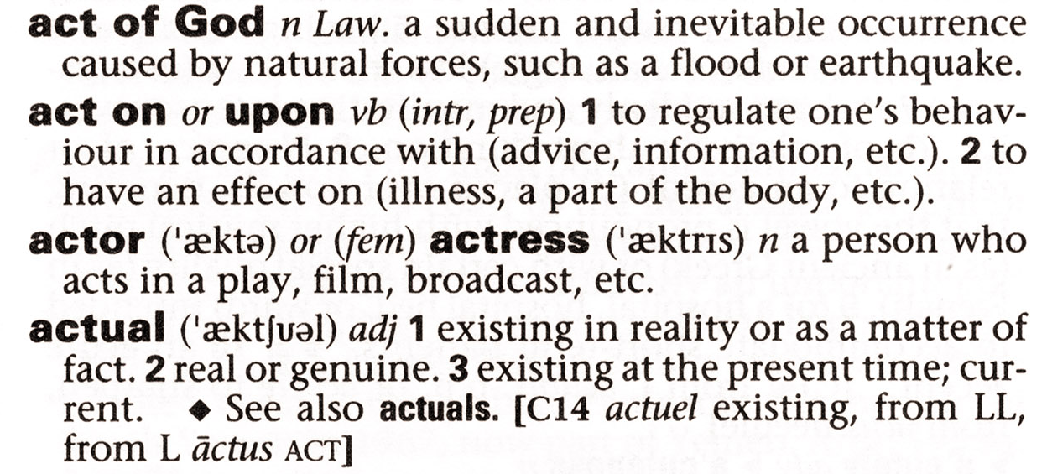
Aside: Dictionaries
Before we dive into today’s work, there is one concept we’d like to revisit in more detail
A dictionary, or “dict”, is a data type in Python
It allows us to store values under keys
Think of a real-life dictionary
Slide 3/11

Slide 47
Aside: Dictionaries
Before we dive into today’s work, there is one concept we’d like to revisit in more detail
A dictionary, or “dict”, is a data type in Python
It allows us to store values under keys
Think of a real-life dictionary
You look up a word (the key)
Slide 3/11

Slide 48
Aside: Dictionaries
Before we dive into today’s work, there is one concept we’d like to revisit in more detail
A dictionary, or “dict”, is a data type in Python
It allows us to store values under keys
Think of a real-life dictionary
You look up a word (the key)
key (the name you look up!)
Slide 3/11

Slide 49
Aside: Dictionaries
Before we dive into today’s work, there is one concept we’d like to revisit in more detail
A dictionary, or “dict”, is a data type in Python
It allows us to store values under keys
Think of a real-life dictionary
You look up a word (the key)
key (the name you look up!)
Slide 3/11

Slide 50
Aside: Dictionaries
Before we dive into today’s work, there is one concept we’d like to revisit in more detail
A dictionary, or “dict”, is a data type in Python
It allows us to store values under keys
Think of a real-life dictionary
You look up a word (the key)
Slide 3/11

Slide 51
Aside: Dictionaries
Before we dive into today’s work, there is one concept we’d like to revisit in more detail
A dictionary, or “dict”, is a data type in Python
It allows us to store values under keys
Think of a real-life dictionary
You look up a word (the key)
You read its definition (the value)
Slide 3/11

Slide 52
Aside: Dictionaries
Before we dive into today’s work, there is one concept we’d like to revisit in more detail
A dictionary, or “dict”, is a data type in Python
It allows us to store values under keys
Think of a real-life dictionary
You look up a word (the key)
You read its definition (the value)
Value (the information you get back!)
Slide 3/11

Slide 53
Aside: Dictionaries
Before we dive into today’s work, there is one concept we’d like to revisit in more detail
A dictionary, or “dict”, is a data type in Python
It allows us to store values under keys
Think of a real-life dictionary
You look up a word (the key)
You read its definition (the value)
Value (the information you get back!)
Slide 3/11

Slide 54
Aside: Dictionaries
Before we dive into today’s work, there is one concept we’d like to revisit in more detail
A dictionary, or “dict”, is a data type in Python
It allows us to store values under keys
Think of a real-life dictionary
You look up a word (the key)
You read its definition (the value)
Slide 3/11

Slide 55
Aside: Dictionaries
Before we dive into today’s work, there is one concept we’d like to revisit in more detail
A dictionary, or “dict”, is a data type in Python
It allows us to store values under keys
Think of a real-life dictionary
You look up a word (the key)
You read its definition (the value)
In the same way, a Python dict lets you
Slide 3/11

Slide 56
Aside: Dictionaries
Before we dive into today’s work, there is one concept we’d like to revisit in more detail
A dictionary, or “dict”, is a data type in Python
It allows us to store values under keys
Think of a real-life dictionary
You look up a word (the key)
You read its definition (the value)
In the same way, a Python dict lets you
You look up a key
Slide 3/11

Slide 57
Aside: Dictionaries
Before we dive into today’s work, there is one concept we’d like to revisit in more detail
A dictionary, or “dict”, is a data type in Python
It allows us to store values under keys
Think of a real-life dictionary
You look up a word (the key)
You read its definition (the value)
In the same way, a Python dict lets you
You look up a key
Get back the value associated with it
Slide 3/11

Slide 58
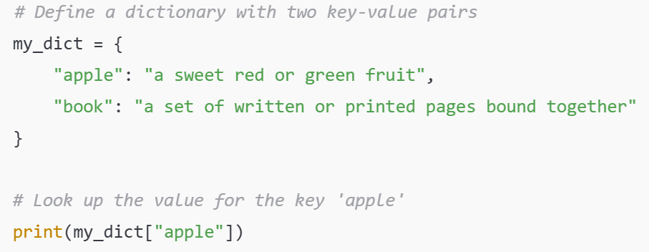
Aside: Dictionaries
Before we dive into today’s work, there is one concept we’d like to revisit in more detail
A dictionary, or “dict”, is a data type in Python
It allows us to store values under keys
Think of a real-life dictionary
You look up a word (the key)
You read its definition (the value)
In the same way, a Python dict lets you
You look up a key
Get back the value associated with it
Slide 3/11

Slide 59
Aside: Dictionaries
Before we dive into today’s work, there is one concept we’d like to revisit in more detail
A dictionary, or “dict”, is a data type in Python
It allows us to store values under keys
Think of a real-life dictionary
You look up a word (the key)
You read its definition (the value)
In the same way, a Python dict lets you
You look up a key
Get back the value associated with it
Slide 3/11

Slide 60
Aside: Dictionaries
Before we dive into today’s work, there is one concept we’d like to revisit in more detail
A dictionary, or “dict”, is a data type in Python
It allows us to store values under keys
Think of a real-life dictionary
You look up a word (the key)
You read its definition (the value)
In the same way, a Python dict lets you
You look up a key
Get back the value associated with it
Slide 3/11

Slide 61
Aside: Dictionaries
Before we dive into today’s work, there is one concept we’d like to revisit in more detail
A dictionary, or “dict”, is a data type in Python
It allows us to store values under keys
Think of a real-life dictionary
You look up a word (the key)
You read its definition (the value)
In the same way, a Python dict lets you
You look up a key
Get back the value associated with it
Slide 3/11

Slide 62
Aside: Dictionaries
Before we dive into today’s work, there is one concept we’d like to revisit in more detail
A dictionary, or “dict”, is a data type in Python
It allows us to store values under keys
Think of a real-life dictionary
You look up a word (the key)
You read its definition (the value)
In the same way, a Python dict lets you
You look up a key
Get back the value associated with it
Name of the dictionary
Slide 3/11

Slide 63
Aside: Dictionaries
Before we dive into today’s work, there is one concept we’d like to revisit in more detail
A dictionary, or “dict”, is a data type in Python
It allows us to store values under keys
Think of a real-life dictionary
You look up a word (the key)
You read its definition (the value)
In the same way, a Python dict lets you
You look up a key
Get back the value associated with it
Slide 3/11

Slide 64
Aside: Dictionaries
Before we dive into today’s work, there is one concept we’d like to revisit in more detail
A dictionary, or “dict”, is a data type in Python
It allows us to store values under keys
Think of a real-life dictionary
You look up a word (the key)
You read its definition (the value)
In the same way, a Python dict lets you
You look up a key
Get back the value associated with it
Assignment operator
Slide 3/11

Slide 65
Aside: Dictionaries
Before we dive into today’s work, there is one concept we’d like to revisit in more detail
A dictionary, or “dict”, is a data type in Python
It allows us to store values under keys
Think of a real-life dictionary
You look up a word (the key)
You read its definition (the value)
In the same way, a Python dict lets you
You look up a key
Get back the value associated with it
Slide 3/11

Slide 66
Aside: Dictionaries
Before we dive into today’s work, there is one concept we’d like to revisit in more detail
A dictionary, or “dict”, is a data type in Python
It allows us to store values under keys
Think of a real-life dictionary
You look up a word (the key)
You read its definition (the value)
In the same way, a Python dict lets you
You look up a key
Get back the value associated with it
Slide 3/11

Slide 67
Aside: Dictionaries
Before we dive into today’s work, there is one concept we’d like to revisit in more detail
A dictionary, or “dict”, is a data type in Python
It allows us to store values under keys
Think of a real-life dictionary
You look up a word (the key)
You read its definition (the value)
In the same way, a Python dict lets you
You look up a key
Get back the value associated with it
Slide 3/11

Slide 68
Aside: Dictionaries
Before we dive into today’s work, there is one concept we’d like to revisit in more detail
A dictionary, or “dict”, is a data type in Python
It allows us to store values under keys
Think of a real-life dictionary
You look up a word (the key)
You read its definition (the value)
In the same way, a Python dict lets you
You look up a key
Get back the value associated with it
Curly braces defining the dictionary
Slide 3/11

Slide 69
Aside: Dictionaries
Before we dive into today’s work, there is one concept we’d like to revisit in more detail
A dictionary, or “dict”, is a data type in Python
It allows us to store values under keys
Think of a real-life dictionary
You look up a word (the key)
You read its definition (the value)
In the same way, a Python dict lets you
You look up a key
Get back the value associated with it
Slide 3/11

Slide 70
Aside: Dictionaries
Before we dive into today’s work, there is one concept we’d like to revisit in more detail
A dictionary, or “dict”, is a data type in Python
It allows us to store values under keys
Think of a real-life dictionary
You look up a word (the key)
You read its definition (the value)
In the same way, a Python dict lets you
You look up a key
Get back the value associated with it
key (the name you look up!)
Slide 3/11

Slide 71
Aside: Dictionaries
Before we dive into today’s work, there is one concept we’d like to revisit in more detail
A dictionary, or “dict”, is a data type in Python
It allows us to store values under keys
Think of a real-life dictionary
You look up a word (the key)
You read its definition (the value)
In the same way, a Python dict lets you
You look up a key
Get back the value associated with it
Slide 3/11

Slide 72
Aside: Dictionaries
Before we dive into today’s work, there is one concept we’d like to revisit in more detail
A dictionary, or “dict”, is a data type in Python
It allows us to store values under keys
Think of a real-life dictionary
You look up a word (the key)
You read its definition (the value)
In the same way, a Python dict lets you
You look up a key
Get back the value associated with it
colon – tells us this is a “key : value” pair
Slide 3/11

Slide 73
Aside: Dictionaries
Before we dive into today’s work, there is one concept we’d like to revisit in more detail
A dictionary, or “dict”, is a data type in Python
It allows us to store values under keys
Think of a real-life dictionary
You look up a word (the key)
You read its definition (the value)
In the same way, a Python dict lets you
You look up a key
Get back the value associated with it
Slide 3/11

Slide 74
Aside: Dictionaries
Before we dive into today’s work, there is one concept we’d like to revisit in more detail
A dictionary, or “dict”, is a data type in Python
It allows us to store values under keys
Think of a real-life dictionary
You look up a word (the key)
You read its definition (the value)
In the same way, a Python dict lets you
You look up a key
Get back the value associated with it
Value (the information you get back!)
Slide 3/11

Slide 75
Aside: Dictionaries
Before we dive into today’s work, there is one concept we’d like to revisit in more detail
A dictionary, or “dict”, is a data type in Python
It allows us to store values under keys
Think of a real-life dictionary
You look up a word (the key)
You read its definition (the value)
In the same way, a Python dict lets you
You look up a key
Get back the value associated with it
Slide 3/11

Slide 76
Aside: Dictionaries
Before we dive into today’s work, there is one concept we’d like to revisit in more detail
A dictionary, or “dict”, is a data type in Python
It allows us to store values under keys
Think of a real-life dictionary
You look up a word (the key)
You read its definition (the value)
In the same way, a Python dict lets you
You look up a key
Get back the value associated with it
This will print: a sweet red or green fruit
Slide 3/11

Slide 77
Aside: Dictionaries
Before we dive into today’s work, there is one concept we’d like to revisit in more detail
A dictionary, or “dict”, is a data type in Python
It allows us to store values under keys
Think of a real-life dictionary
You look up a word (the key)
You read its definition (the value)
In the same way, a Python dict lets you
You look up a key
Get back the value associated with it
This will print: a sweet red or green fruit
Slide 3/11

Slide 78
Aside: Dictionaries
Before we dive into today’s work, there is one concept we’d like to revisit in more detail
A dictionary, or “dict”, is a data type in Python
It allows us to store values under keys
Think of a real-life dictionary
You look up a word (the key)
You read its definition (the value)
In the same way, a Python dict lets you
You look up a key
Get back the value associated with it
Slide 3/11

Slide 79
Aside: Dictionaries
Slide 4/11

Slide 80
Aside: Dictionaries
New values can be added to the dictionary using the syntax
Slide 4/11

Slide 81
Aside: Dictionaries
New values can be added to the dictionary using the syntax
my_dict[key] = value
Slide 4/11

Slide 82
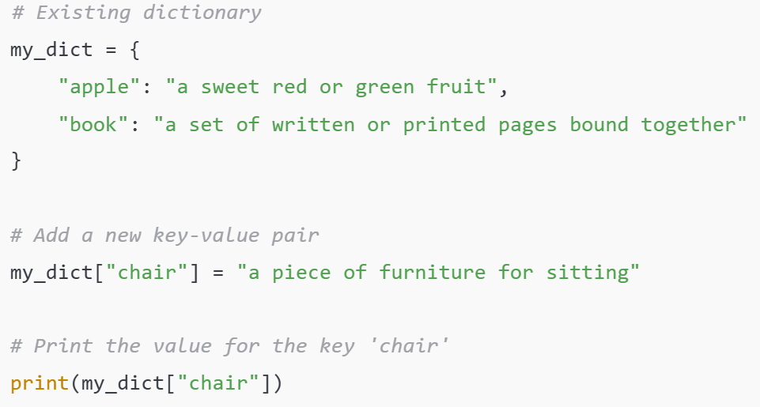
Aside: Dictionaries
New values can be added to the dictionary using the syntax
my_dict[key] = value
Slide 4/11

Slide 83
Aside: Dictionaries
New values can be added to the dictionary using the syntax
my_dict[key] = value
Slide 4/11

Slide 84
Aside: Dictionaries
New values can be added to the dictionary using the syntax
my_dict[key] = value
Slide 4/11

Slide 85
Aside: Dictionaries
New values can be added to the dictionary using the syntax
my_dict[key] = value
Slide 4/11

Slide 86
Aside: Dictionaries
New values can be added to the dictionary using the syntax
my_dict[key] = value
Prints: a piece of furniture for sitting
Slide 4/11

Slide 87
Aside: Dictionaries
New values can be added to the dictionary using the syntax
my_dict[key] = value
Slide 4/11

Slide 88
Aside: Dictionaries
New values can be added to the dictionary using the syntax
my_dict[key] = value
And keys and values can be any datatype you like
Slide 4/11

Slide 89
Aside: Dictionaries
New values can be added to the dictionary using the syntax
my_dict[key] = value
And keys and values can be any datatype you like
They don’t have to be strings!
Slide 4/11

Slide 90
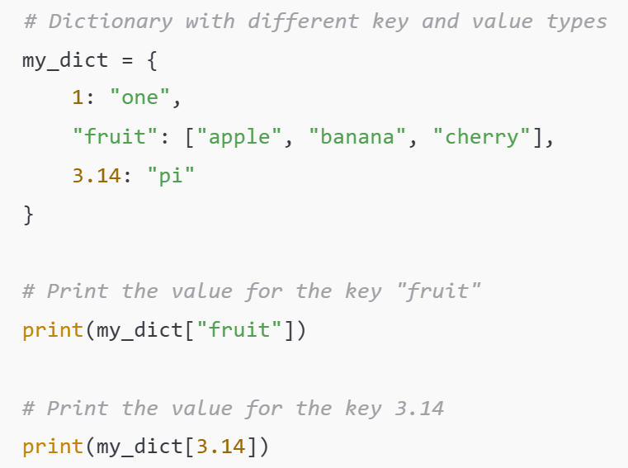
Aside: Dictionaries
New values can be added to the dictionary using the syntax
my_dict[key] = value
And keys and values can be any datatype you like
They don’t have to be strings!
Slide 4/11

Slide 91
Aside: Dictionaries
New values can be added to the dictionary using the syntax
my_dict[key] = value
And keys and values can be any datatype you like
They don’t have to be strings!
Slide 4/11

Slide 92
Aside: Dictionaries
New values can be added to the dictionary using the syntax
my_dict[key] = value
And keys and values can be any datatype you like
They don’t have to be strings!
Slide 4/11

Slide 93
Aside: Dictionaries
New values can be added to the dictionary using the syntax
my_dict[key] = value
And keys and values can be any datatype you like
They don’t have to be strings!
Prints: [“apple”, “banana”, “cherry”]
Slide 4/11

Slide 94
Aside: Dictionaries
New values can be added to the dictionary using the syntax
my_dict[key] = value
And keys and values can be any datatype you like
They don’t have to be strings!
Slide 4/11

Slide 95
Aside: Dictionaries
New values can be added to the dictionary using the syntax
my_dict[key] = value
And keys and values can be any datatype you like
They don’t have to be strings!
Slide 4/11

Slide 96
Aside: Dictionaries
New values can be added to the dictionary using the syntax
my_dict[key] = value
And keys and values can be any datatype you like
They don’t have to be strings!
Prints: “pi”
Slide 4/11

Slide 97
Aside: Dictionaries
New values can be added to the dictionary using the syntax
my_dict[key] = value
And keys and values can be any datatype you like
They don’t have to be strings!
Slide 4/11

Slide 98
Aside: Dictionaries
New values can be added to the dictionary using the syntax
my_dict[key] = value
And keys and values can be any datatype you like
They don’t have to be strings!
Dictionaries will be crucial to some of today’s challenges as well as throughout the rest of this course
Slide 4/11

Slide 99
Aside: Dictionaries
New values can be added to the dictionary using the syntax
my_dict[key] = value
And keys and values can be any datatype you like
They don’t have to be strings!
Dictionaries will be crucial to some of today’s challenges as well as throughout the rest of this course
If you are unsure about these please take the time to read over:
Slide 4/11

Slide 100
Aside: Dictionaries
New values can be added to the dictionary using the syntax
my_dict[key] = value
And keys and values can be any datatype you like
They don’t have to be strings!
Dictionaries will be crucial to some of today’s challenges as well as throughout the rest of this course
If you are unsure about these please take the time to read over:
Week 1’s intermediate notebook Section: Sets and Dictionaries
Slide 4/11

Slide 101
Aside: Dictionaries
New values can be added to the dictionary using the syntax
my_dict[key] = value
And keys and values can be any datatype you like
They don’t have to be strings!
Dictionaries will be crucial to some of today’s challenges as well as throughout the rest of this course
If you are unsure about these please take the time to read over:
Week 1’s intermediate notebook Section: Sets and Dictionaries
You can do this either in today’s class or over the week 6 break
Slide 4/11

Slide 102
Tackling Difficult Problems
Slide 5/11

Slide 103
Tackling Difficult Problems
Today, we’re going to be looking at some challenge problems
Slide 5/11

Slide 104

Tackling Difficult Problems
Today, we’re going to be looking at some challenge problems
Slide 5/11

Slide 105
Tackling Difficult Problems
Horrendous Assignment
Today, we’re going to be looking at some challenge problems
Slide 5/11

Slide 106
Tackling Difficult Problems
Today, we’re going to be looking at some challenge problems
Slide 5/11

Slide 107
Tackling Difficult Problems
Today, we’re going to be looking at some challenge problems
Well-prepared SCIF10002 student
Slide 5/11

Slide 108
Tackling Difficult Problems
Today, we’re going to be looking at some challenge problems
Slide 5/11

Slide 109
Tackling Difficult Problems
Today, we’re going to be looking at some challenge problems
These problems may feel a little more open-ended than you are used to
Slide 5/11

Slide 110
Tackling Difficult Problems
Today, we’re going to be looking at some challenge problems
These problems may feel a little more open-ended than you are used to
This can be a little daunting at first
Slide 5/11

Slide 111
Tackling Difficult Problems
Today, we’re going to be looking at some challenge problems
These problems may feel a little more open-ended than you are used to
This can be a little daunting at first
But do not worry…
Slide 5/11

Slide 112
Tackling Difficult Problems
Today, we’re going to be looking at some challenge problems
These problems may feel a little more open-ended than you are used to
This can be a little daunting at first
But do not worry…
You already have all the skills necessary to complete the tasks!
Slide 5/11

Slide 113
Tackling Difficult Problems
Today, we’re going to be looking at some challenge problems
These problems may feel a little more open-ended than you are used to
This can be a little daunting at first
But do not worry…
You already have all the skills necessary to complete the tasks!
When faced with a difficult coding problem, here’s some general tips to help you get started out
Slide 5/11

Slide 114
Tackling Difficult Problems
Today, we’re going to be looking at some challenge problems
These problems may feel a little more open-ended than you are used to
This can be a little daunting at first
But do not worry…
You already have all the skills necessary to complete the tasks!
When faced with a difficult coding problem, here’s some general tips to help you get started out
Slide 5/11

Slide 115

Tackling Difficult Problems
Today, we’re going to be looking at some challenge problems
These problems may feel a little more open-ended than you are used to
This can be a little daunting at first
But do not worry…
You already have all the skills necessary to complete the tasks!
When faced with a difficult coding problem, here’s some general tips to help you get started out
Slide 5/11

Slide 116
Tackling Difficult Problems
Today, we’re going to be looking at some challenge problems
These problems may feel a little more open-ended than you are used to
This can be a little daunting at first
But do not worry…
You already have all the skills necessary to complete the tasks!
When faced with a difficult coding problem, here’s some general tips to help you get started out
Slide 5/11

Slide 117
Tackling Difficult Problems
Slide 6/11

Slide 118
Tackling Difficult Problems
Slide 6/11

Slide 119
Tackling Difficult Problems
Plan before you code
Slide 6/11

Slide 120
Tackling Difficult Problems
Plan before you code
Before you start coding, grab a pen and paper and try to solve the problem by hand!
Slide 6/11

Slide 121
Tackling Difficult Problems
Plan before you code
Before you start coding, grab a pen and paper and try to solve the problem by hand!
Think about how you would do the computation first!
Slide 6/11

Slide 122
Tackling Difficult Problems
Plan before you code
Before you start coding, grab a pen and paper and try to solve the problem by hand!
Slide 6/11

Slide 123
Tackling Difficult Problems
Plan before you code
Before you start coding, grab a pen and paper and try to solve the problem by hand!
Clarify inputs and outputs
Slide 6/11

Slide 124
Tackling Difficult Problems
Plan before you code
Before you start coding, grab a pen and paper and try to solve the problem by hand!
Clarify inputs and outputs
When getting started think about what you have and what you need – these are probably your inputs and outputs
Slide 6/11

Slide 125
Tackling Difficult Problems
Plan before you code
Before you start coding, grab a pen and paper and try to solve the problem by hand!
Clarify inputs and outputs
When getting started think about what you have and what you need – these are probably your inputs and outputs
Slide 6/11

Slide 126
Tackling Difficult Problems
Plan before you code
Before you start coding, grab a pen and paper and try to solve the problem by hand!
Clarify inputs and outputs
When getting started think about what you have and what you need – these are probably your inputs and outputs
Ask Yourself:
Slide 6/11

Slide 127
Tackling Difficult Problems
Plan before you code
Before you start coding, grab a pen and paper and try to solve the problem by hand!
Clarify inputs and outputs
When getting started think about what you have and what you need – these are probably your inputs and outputs
Ask Yourself:
What information do I have before I start coding?
Slide 6/11

Slide 128
Tackling Difficult Problems
Plan before you code
Before you start coding, grab a pen and paper and try to solve the problem by hand!
Clarify inputs and outputs
When getting started think about what you have and what you need – these are probably your inputs and outputs
Ask Yourself:
What information do I have before I start coding?
What do I want my code to produce?
Slide 6/11

Slide 129
Tackling Difficult Problems
Plan before you code
Before you start coding, grab a pen and paper and try to solve the problem by hand!
Clarify inputs and outputs
When getting started think about what you have and what you need – these are probably your inputs and outputs
Slide 6/11

Slide 130
Tackling Difficult Problems
Plan before you code
Before you start coding, grab a pen and paper and try to solve the problem by hand!
Clarify inputs and outputs
When getting started think about what you have and what you need – these are probably your inputs and outputs
Look for structure and repetition
Slide 6/11

Slide 131
Tackling Difficult Problems
Plan before you code
Before you start coding, grab a pen and paper and try to solve the problem by hand!
Clarify inputs and outputs
When getting started think about what you have and what you need – these are probably your inputs and outputs
Look for structure and repetition
When you convert your thoughts to code, ask yourself which parts of the code are repetitive or self-contained
Slide 6/11

Slide 132
Tackling Difficult Problems
Plan before you code
Before you start coding, grab a pen and paper and try to solve the problem by hand!
Clarify inputs and outputs
When getting started think about what you have and what you need – these are probably your inputs and outputs
Look for structure and repetition
When you convert your thoughts to code, ask yourself which parts of the code are repetitive or self-contained
Repetitive computation – think loops!
Self contained-computation – think functions!
Slide 6/11

Slide 133
Tackling Difficult Problems
Plan before you code
Before you start coding, grab a pen and paper and try to solve the problem by hand!
Clarify inputs and outputs
When getting started think about what you have and what you need – these are probably your inputs and outputs
Look for structure and repetition
When you convert your thoughts to code, ask yourself which parts of the code are repetitive or self-contained
Repetitive computation – think loops!
Self contained-computation – think functions!
Slide 6/11

Slide 134
Tackling Difficult Problems
Plan before you code
Before you start coding, grab a pen and paper and try to solve the problem by hand!
Clarify inputs and outputs
When getting started think about what you have and what you need – these are probably your inputs and outputs
Look for structure and repetition
When you convert your thoughts to code, ask yourself which parts of the code are repetitive or self-contained
Repetitive computation – think loops!
Self contained-computation – think functions!
Slide 6/11

Slide 135
Tackling Difficult Problems
Plan before you code
Before you start coding, grab a pen and paper and try to solve the problem by hand!
Clarify inputs and outputs
When getting started think about what you have and what you need – these are probably your inputs and outputs
Look for structure and repetition
When you convert your thoughts to code, ask yourself which parts of the code are repetitive or self-contained
Repetitive computation – think loops!
Self contained-computation – think functions!
Slide 6/11

Slide 136
Tackling Difficult Problems
Plan before you code
Before you start coding, grab a pen and paper and try to solve the problem by hand!
Clarify inputs and outputs
When getting started think about what you have and what you need – these are probably your inputs and outputs
Look for structure and repetition
When you convert your thoughts to code, ask yourself which parts of the code are repetitive or self-contained
Slide 6/11

Slide 137
Tackling Difficult Problems
Slide 7/11

Slide 138
Tackling Difficult Problems
Divide and Conquer
Slide 7/11

Slide 139
Tackling Difficult Problems
Divide and Conquer
Try to break the task down into smaller chunks where possible!
Slide 7/11

Slide 140
Tackling Difficult Problems
Divide and Conquer
Try to break the task down into smaller chunks where possible!
How can we make the task simpler/more manageable?
Slide 7/11

Slide 141
Tackling Difficult Problems
Divide and Conquer
Try to break the task down into smaller chunks where possible!
Slide 7/11

Slide 142
Tackling Difficult Problems
Divide and Conquer
Try to break the task down into smaller chunks where possible!
Talk things through
Slide 7/11

Slide 143
Tackling Difficult Problems
Divide and Conquer
Try to break the task down into smaller chunks where possible!
Talk things through
If you are struggling to get started, talk through the problem with a friend or peer
Slide 7/11

Slide 144
Tackling Difficult Problems
Divide and Conquer
Try to break the task down into smaller chunks where possible!
Talk things through
If you are struggling to get started, talk through the problem with a friend or peer
Talking things through can help organise your thoughts!
Slide 7/11

Slide 145
Tackling Difficult Problems
Divide and Conquer
Try to break the task down into smaller chunks where possible!
Talk things through
If you are struggling to get started, talk through the problem with a friend or peer
Slide 7/11

Slide 146
Tackling Difficult Problems
Divide and Conquer
Try to break the task down into smaller chunks where possible!
Talk things through
If you are struggling to get started, talk through the problem with a friend or peer
Use Resources
Slide 7/11

Slide 147
Tackling Difficult Problems
Divide and Conquer
Try to break the task down into smaller chunks where possible!
Talk things through
If you are struggling to get started, talk through the problem with a friend or peer
Use Resources
Googling and looking up documentation are key coding skills
Slide 7/11

Slide 148
Tackling Difficult Problems
Divide and Conquer
Try to break the task down into smaller chunks where possible!
Talk things through
If you are struggling to get started, talk through the problem with a friend or peer
Use Resources
Googling and looking up documentation are key coding skills
Don’t be afraid to google!
Slide 7/11

Slide 149
Tackling Difficult Problems
Divide and Conquer
Try to break the task down into smaller chunks where possible!
Talk things through
If you are struggling to get started, talk through the problem with a friend or peer
Use Resources
Googling and looking up documentation are key coding skills
Slide 7/11

Slide 150
Tackling Difficult Problems
Divide and Conquer
Try to break the task down into smaller chunks where possible!
Talk things through
If you are struggling to get started, talk through the problem with a friend or peer
Use Resources
Googling and looking up documentation are key coding skills
Trust your own process
Slide 7/11

Slide 151
Tackling Difficult Problems
Divide and Conquer
Try to break the task down into smaller chunks where possible!
Talk things through
If you are struggling to get started, talk through the problem with a friend or peer
Use Resources
Googling and looking up documentation are key coding skills
Trust your own process
Try to avoid using AI to make structural decisions about your code
Slide 7/11

Slide 152
Tackling Difficult Problems
Divide and Conquer
Try to break the task down into smaller chunks where possible!
Talk things through
If you are struggling to get started, talk through the problem with a friend or peer
Use Resources
Googling and looking up documentation are key coding skills
Trust your own process
Try to avoid using AI to make structural decisions about your code
It’s easier to understand and debug code if it comes from your own reasoning!
Slide 7/11

Slide 153
Tackling Difficult Problems
Divide and Conquer
Try to break the task down into smaller chunks where possible!
Talk things through
If you are struggling to get started, talk through the problem with a friend or peer
Use Resources
Googling and looking up documentation are key coding skills
Trust your own process
Try to avoid using AI to make structural decisions about your code
Slide 7/11

Slide 154
Tackling Difficult Problems
Slide 8/11

Slide 155
Tackling Difficult Problems
Above all, remember…
Slide 8/11

Slide 156
Tackling Difficult Problems
Above all, remember…
Coding can be hard!
Slide 8/11

Slide 157
Tackling Difficult Problems
Above all, remember…
Coding can be hard!
It can feel like you are running into the same problems over and over again sometimes
Slide 8/11

Slide 158
Tackling Difficult Problems
Above all, remember…
Coding can be hard!
It can feel like you are running into the same problems over and over again sometimes
This is a normal part of the process
Slide 8/11

Slide 159
Tackling Difficult Problems
Above all, remember…
Coding can be hard!
It can feel like you are running into the same problems over and over again sometimes
This is a normal part of the process
If you keep trying you will get there
Slide 8/11

Slide 160
Tackling Difficult Problems
Above all, remember…
Coding can be hard!
It can feel like you are running into the same problems over and over again sometimes
This is a normal part of the process
If you keep trying you will get there
Slide 8/11

Slide 161
Tackling Difficult Problems
Above all, remember…
Coding can be hard!
It can feel like you are running into the same problems over and over again sometimes
This is a normal part of the process
If you keep trying you will get there
Slide 8/11

Slide 162
Tackling Difficult Problems
Above all, remember…
Coding can be hard!
It can feel like you are running into the same problems over and over again sometimes
This is a normal part of the process
If you keep trying you will get there
Slide 8/11

Slide 163
A Worked Example
Slide 9/11

Slide 164
A Worked Example
Let’s go through an example together to see these principles in action:
Slide 9/11

Slide 165
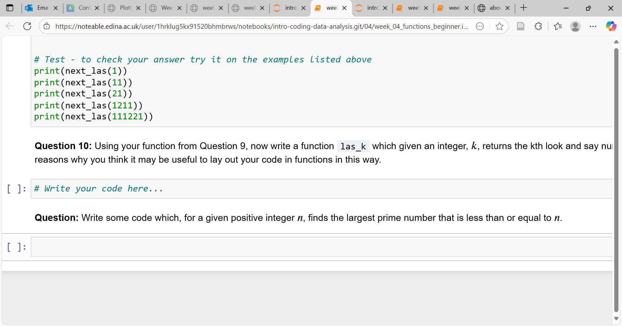
A Worked Example
Let’s go through an example together to see these principles in action:
Slide 9/11

Slide 166
A Worked Example
Let’s go through an example together to see these principles in action:
Slide 9/11

Slide 167
A Worked Example
Let’s go through an example together to see these principles in action:
Slide 9/11

Slide 168
A Worked Example
Let’s go through an example together to see these principles in action:
Slide 9/11

Slide 169
A Worked Example
Let’s go through an example together to see these principles in action:
Slide 9/11

Slide 170
A Worked Example
Let’s go through an example together to see these principles in action:
Principles:
Slide 9/11

Slide 171
A Worked Example
Let’s go through an example together to see these principles in action:
Principles:
Plan before you code
Slide 9/11

Slide 172
A Worked Example
Let’s go through an example together to see these principles in action:
Principles:
Plan before you code
Clarify inputs and outputs
Slide 9/11

Slide 173
A Worked Example
Let’s go through an example together to see these principles in action:
Principles:
Plan before you code
Clarify inputs and outputs
Look for structure and repetition
Slide 9/11

Slide 174
A Worked Example
Let’s go through an example together to see these principles in action:
Principles:
Plan before you code
Clarify inputs and outputs
Look for structure and repetition
Divide and conquer
Slide 9/11

Slide 175
A Worked Example
Let’s go through an example together to see these principles in action:
Principles:
Plan before you code
Clarify inputs and outputs
Look for structure and repetition
Divide and conquer
Talk things through
Slide 9/11

Slide 176
A Worked Example
Let’s go through an example together to see these principles in action:
Principles:
Plan before you code
Clarify inputs and outputs
Look for structure and repetition
Divide and conquer
Talk things through
Trust your own process
Slide 9/11

Slide 177
A Worked Example
Let’s go through an example together to see these principles in action:
Principles:
Plan before you code
Clarify inputs and outputs
Look for structure and repetition
Divide and conquer
Talk things through
Trust your own process
Let’s start out on paper!
Slide 9/11

Slide 178
A Worked Example
Let’s go through an example together to see these principles in action:
Principles:
Plan before you code
Clarify inputs and outputs
Look for structure and repetition
Divide and conquer
Talk things through
Trust your own process
Slide 9/11

Slide 179
Practical
Slide 10/11

Slide 180
Practical
We now move over to Python
Slide 10/11

Slide 181
Practical
We now move over to Python
Please open `week_05_home.ipynb`
Slide 10/11

Slide 182
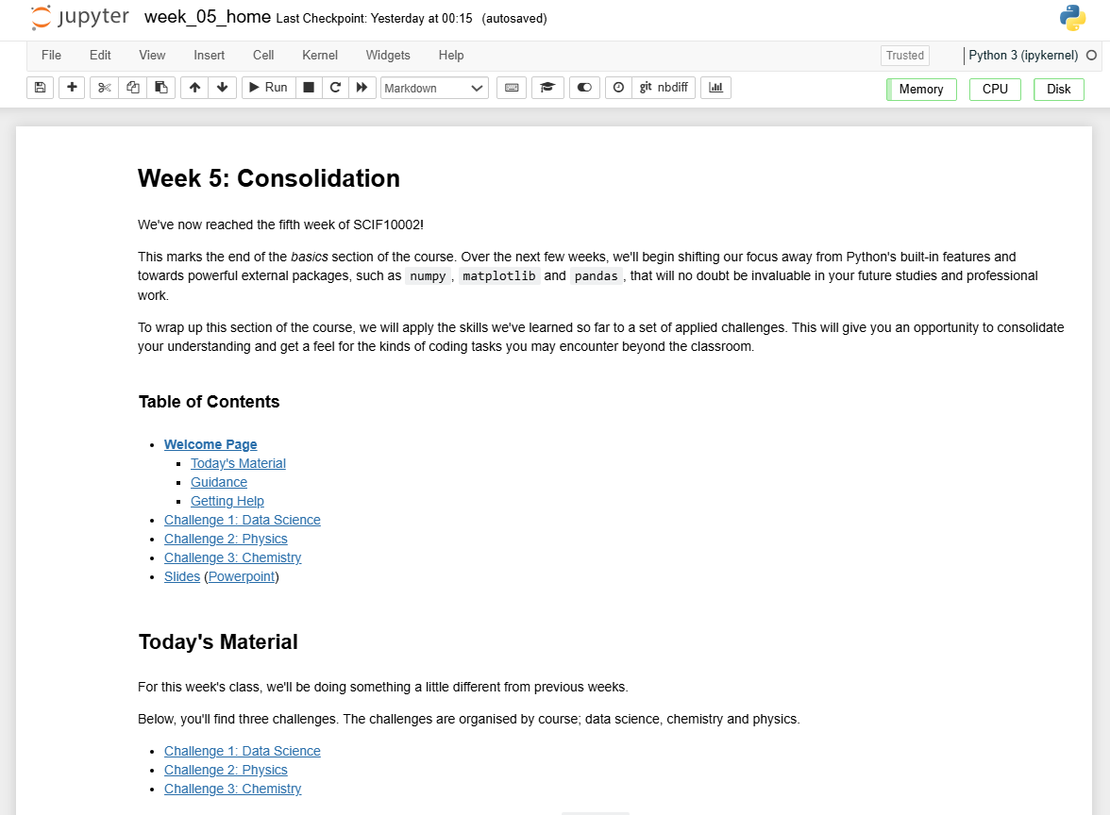
Practical
We now move over to Python
Please open `week_05_home.ipynb`
Slide 10/11

Slide 183
Practical
We now move over to Python
Please open `week_05_home.ipynb`
For the rest of today, you must work through a challenge
Slide 10/11

Slide 184
Practical
We now move over to Python
Please open `week_05_home.ipynb`
For the rest of today, you must work through a challenge
This week is a little different…
Slide 10/11

Slide 185
Practical
We now move over to Python
Please open `week_05_home.ipynb`
For the rest of today, you must work through a challenge
This week is a little different…
Please choose the challenge according to your course
Slide 10/11

Slide 186
Practical
We now move over to Python
Please open `week_05_home.ipynb`
For the rest of today, you must work through a challenge
This week is a little different…
Please choose the challenge according to your course
Chemistry Challenge
Slide 10/11

Slide 187
Practical
We now move over to Python
Please open `week_05_home.ipynb`
For the rest of today, you must work through a challenge
This week is a little different…
Please choose the challenge according to your course
Chemistry Challenge
Slide 10/11

Slide 188
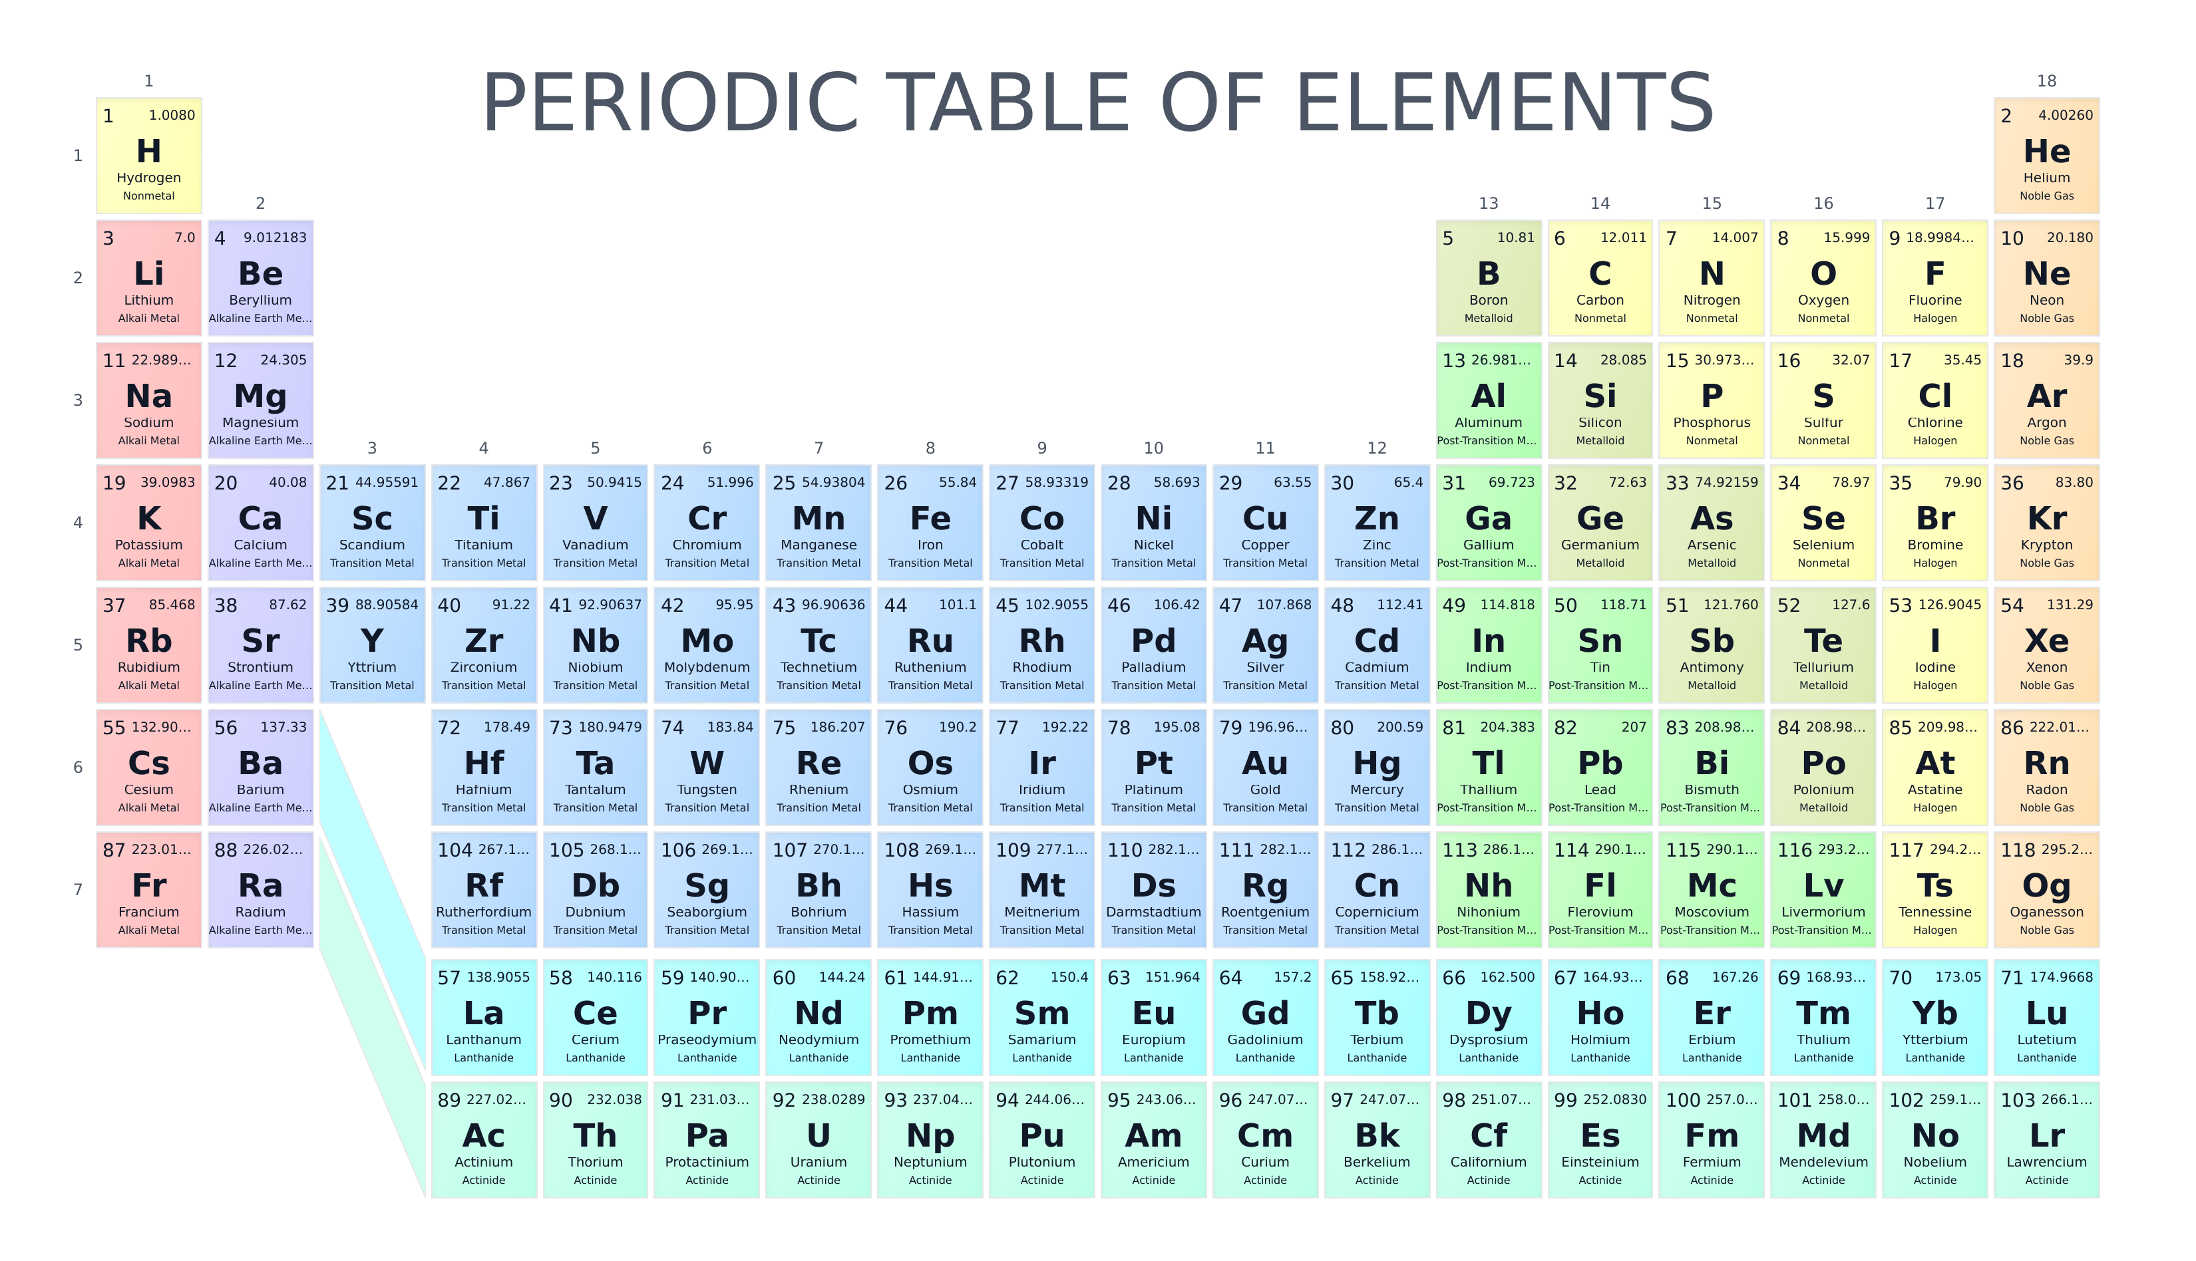
Practical
We now move over to Python
Please open `week_05_home.ipynb`
For the rest of today, you must work through a challenge
This week is a little different…
Please choose the challenge according to your course
Chemistry Challenge
Slide 10/11

Slide 189
Practical
We now move over to Python
Please open `week_05_home.ipynb`
For the rest of today, you must work through a challenge
This week is a little different…
Please choose the challenge according to your course
Chemistry Challenge
Data Science Challenge
Slide 10/11

Slide 190
Practical
We now move over to Python
Please open `week_05_home.ipynb`
For the rest of today, you must work through a challenge
This week is a little different…
Please choose the challenge according to your course
Chemistry Challenge
Data Science Challenge
Slide 10/11

Slide 191
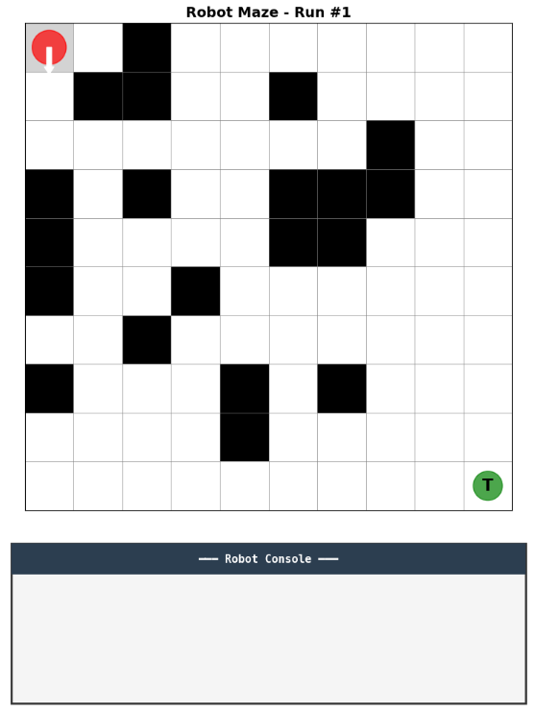
Practical
We now move over to Python
Please open `week_05_home.ipynb`
For the rest of today, you must work through a challenge
This week is a little different…
Please choose the challenge according to your course
Chemistry Challenge
Data Science Challenge
Slide 10/11

Slide 192
Practical
We now move over to Python
Please open `week_05_home.ipynb`
For the rest of today, you must work through a challenge
This week is a little different…
Please choose the challenge according to your course
Chemistry Challenge
Data Science Challenge
Physics Challenge
Slide 10/11

Slide 193
Practical
We now move over to Python
Please open `week_05_home.ipynb`
For the rest of today, you must work through a challenge
This week is a little different…
Please choose the challenge according to your course
Chemistry Challenge
Data Science Challenge
Physics Challenge
Slide 10/11

Slide 194
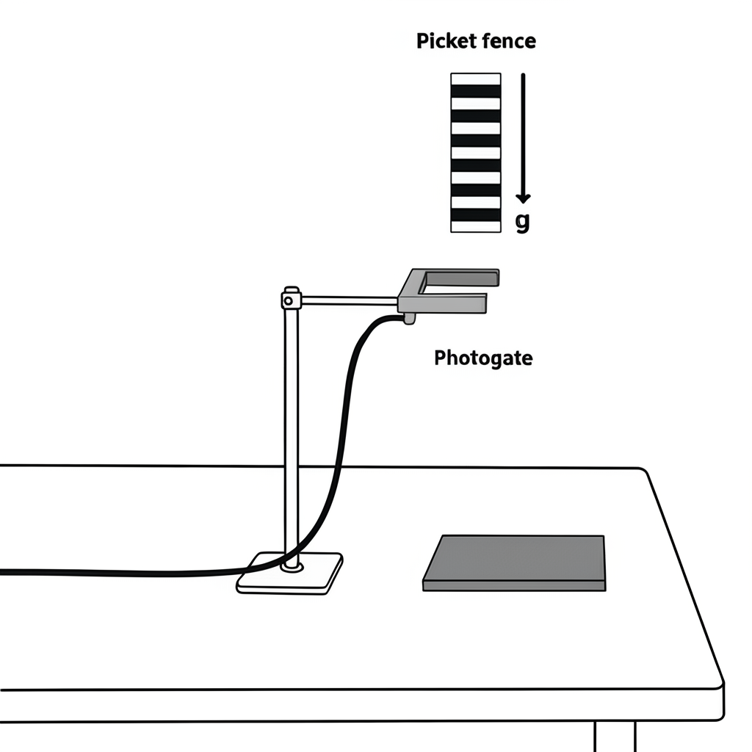
Practical
We now move over to Python
Please open `week_05_home.ipynb`
For the rest of today, you must work through a challenge
This week is a little different…
Please choose the challenge according to your course
Chemistry Challenge
Data Science Challenge
Physics Challenge
Slide 10/11

Slide 195
Practical
We now move over to Python
Please open `week_05_home.ipynb`
For the rest of today, you must work through a challenge
This week is a little different…
Please choose the challenge according to your course
Chemistry Challenge
Data Science Challenge
Physics Challenge
Slide 10/11

Slide 196
Practical
We now move over to Python
Please open `week_05_home.ipynb`
For the rest of today, you must work through a challenge
This week is a little different…
Please choose the challenge according to your course
Chemistry Challenge
Data Science Challenge
Physics Challenge
Slide 10/11

Slide 197
Practical
We now move over to Python
Please open `week_05_home.ipynb`
For the rest of today, you must work through a challenge
This week is a little different…
Please choose the challenge according to your course
Chemistry Challenge
Data Science Challenge
Physics Challenge
If you finish your course’s challenge, try one of the others!
Slide 10/11

Slide 198
Next Time
Lecture 5: Consolidation
Recap: The Course So Far
Tackling Difficult Problems
A Worked Example
Practical
Lecture 6: Introduction to NumPy
Recap: The Course So Far
What is NumPy?
NumPy Arrays
Arrays vs Lists
Practical
Slide 11/11

